Slide 1
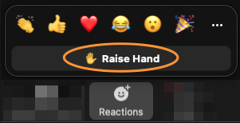
Survey
Your Feedback is important to us to shape our training and certification program.
https://pages.aviatrix.com/ace-professional-survey.html
Raise hand in Zoom when done

Slide 2


